Slide 1

Lime CRM InfoTiles
Serving you the numbers you care about

Slide 2
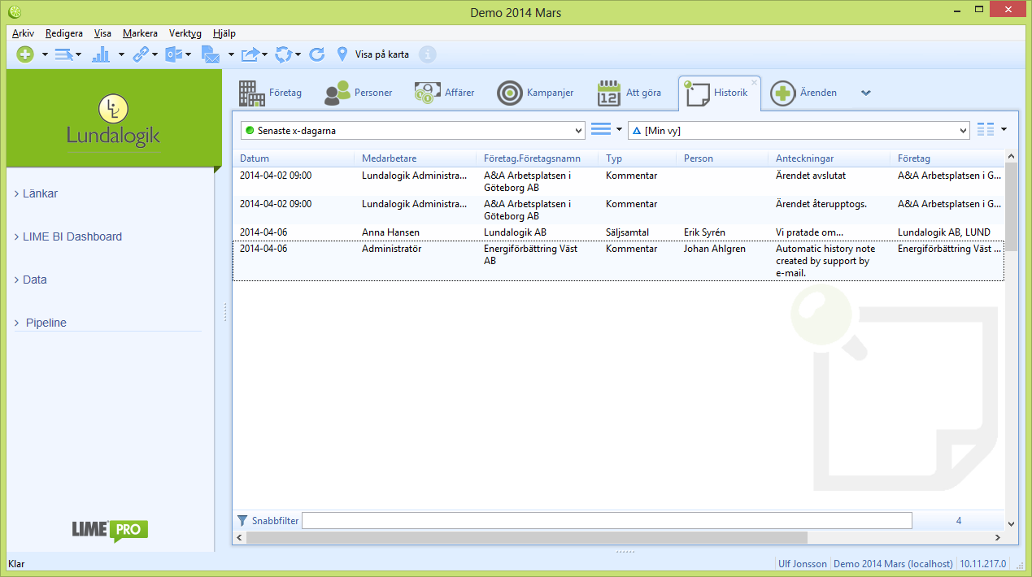
TODAY
Searching for the numbers you care about
2. Select filter
1. Select tab

Slide 3





Lime CRM InfoTiles
Serving you the numbers you care about

Slide 4
Lime CRM InfoTiles
Serving you the numbers you care about

Slide 5
Lime CRM InfoTiles
Serving you the numbers you care about
WHO’S THIS FOR?
EVERYONE!
We truly mean it!

Slide 6
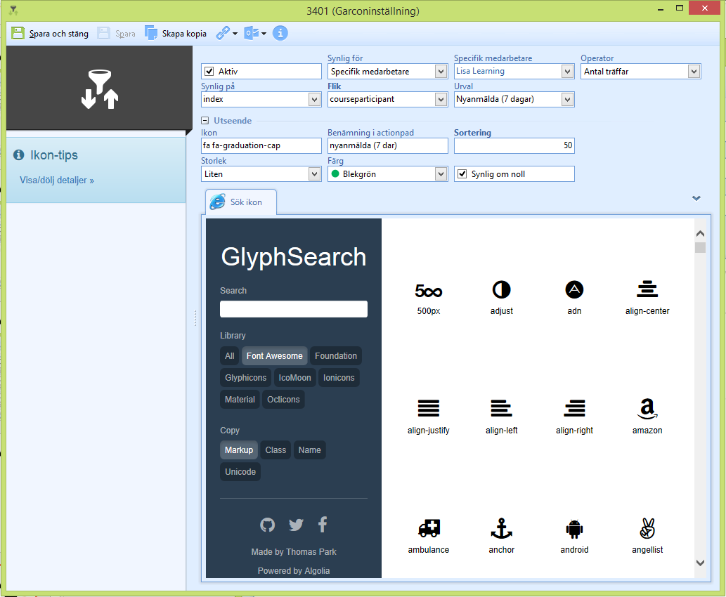
Lime CRM InfoTiles
Serving you the numbers you care about

